Slide 1

The Data Ecosystem: Understanding Data Workflows and Storage Solutions
Exploring Data-driven Insights and Decision Making
Notes:
In this presentation, we will explore the data ecosystem and understand the various workflows and storage solutions that enable data-driven insights and decision-making.

Slide 2
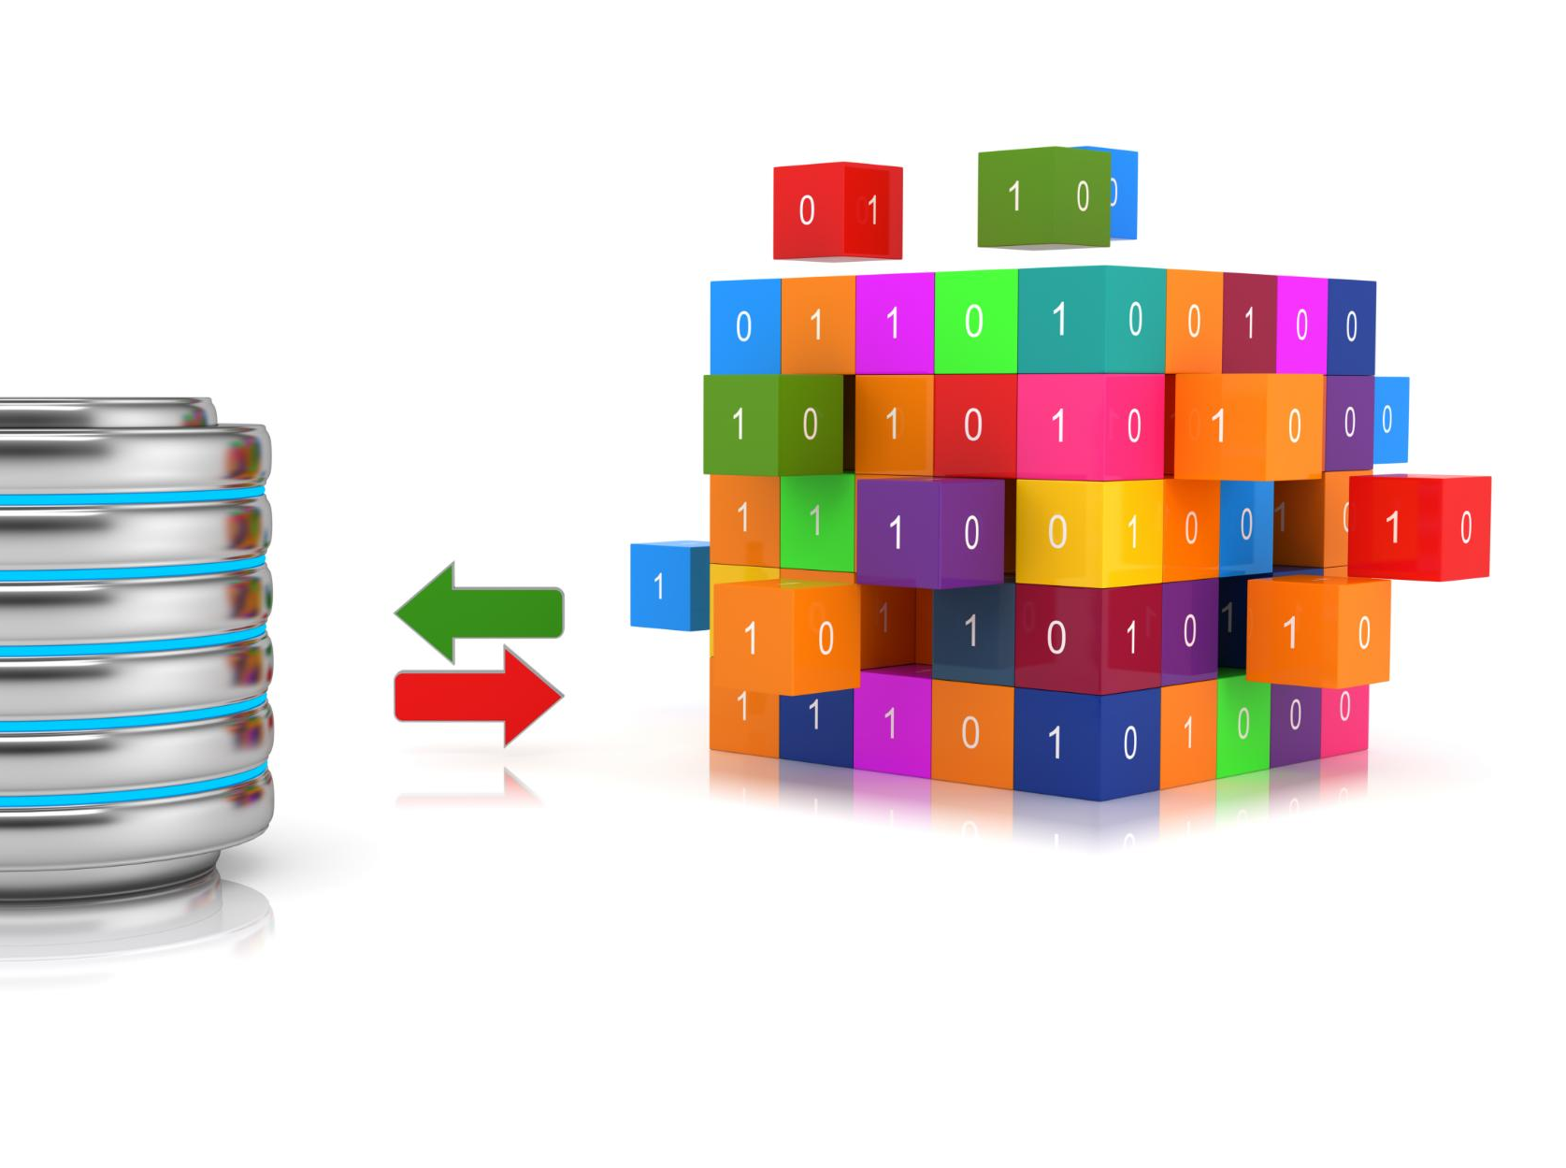
Presentation Overview
Data Workflows
  Data workflows are essential for processing and managing large volumes of data. We'll discuss what data workflows entail and their importance.
Data Ingestion
  The first stage of a data workflow is data ingestion, which involves acquiring and transferring data from various sources into a storage system. We'll discuss different methods of data ingestion.
Data Transformation
  Data transformation involves cleaning, enriching, and converting data into a format that is suitable for processing. We'll discuss the importance of data transformation and its different stages.
Storage Solutions
  We will explore popular storage solutions for data, including data warehouses, data marts, and data lakes. We'll discuss their differences, similarities, and use cases.
Notes:
We will begin by discussing data workflows, which are essential for processing and managing large volumes of data. Then, we will dive into the different stages of a data workflow, including data ingestion, transformation, and processing. We will wrap up by exploring popular storage solutions, such as data warehouses, data marts, and data lakes.

Slide 3
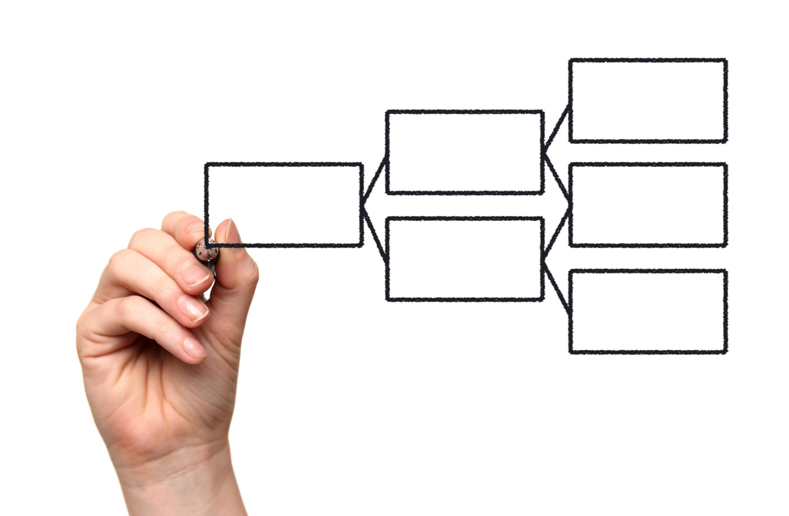
Data Workflows
  Data workflows are a series of steps that a piece of data goes through, from ingestion to storage and analysis. Understanding data workflows is crucial for efficient data management and processing.
Notes:
A data workflow is a series of steps that a piece of data goes through, from ingestion to storage and analysis. Understanding data workflows is crucial for efficient data management and processing.

Slide 4
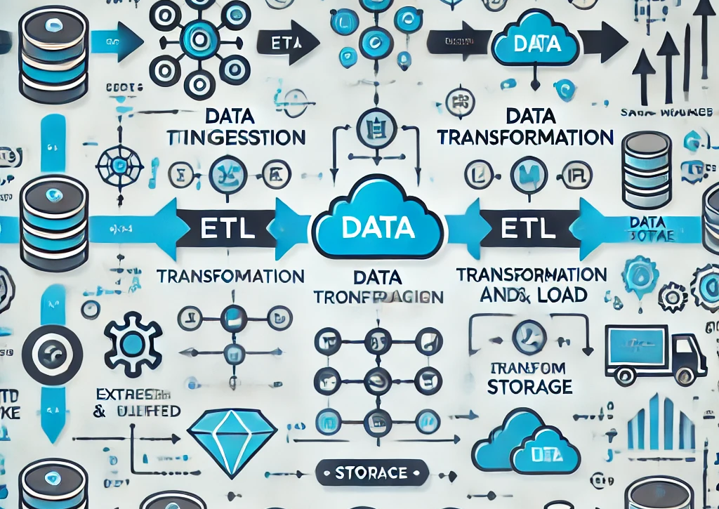
What is a data workflow?
  A data workflow refers to the processes that a piece of data goes through, including ingestion, cleaning, transformation, storage, and analysis. It is essential for managing and processing large volumes of data.
Notes:
In the data lifecycle, a data workflow refers to the processes that a piece of data goes through, including ingestion, cleaning, transformation, storage, and analysis. A data workflow is essential for managing and processing large volumes of data.

Slide 5
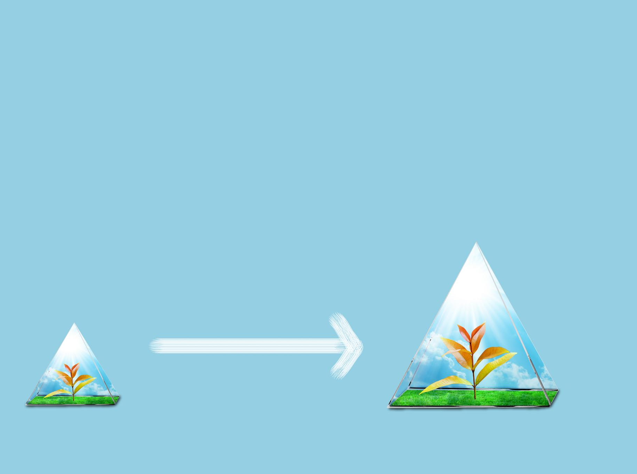
Data Ingestion
Data Ingestion Process
  Data ingestion is the process of importing data from various sources into a data storage system. The process involves organizing, cleaning and processing data to make it ready for use.
Data Pipelines
  Data pipelines are commonly used for data ingestion. They involve the automated movement of data from its source to a storage system, with processing steps and quality checks along the way.
ETL Processes
  ETL (Extract, Transform, Load) processes are used for data ingestion. These processes involve extracting data from various sources, transforming it into a usable format, and loading it into a data storage system.
Batch and Real-Time Data Ingestion
  There are two main approaches to data ingestion: batch and real-time. Batch ingestion involves processing large amounts of data at once, while real-time ingestion involves processing data as it is generated.
Notes:
Data ingestion refers to the process of importing data from various sources into a data storage system. Data pipelines and ETL (Extract, Transform, Load) processes are commonly used for data ingestion. Batch and real-time data ingestion are two main approaches.

Slide 6
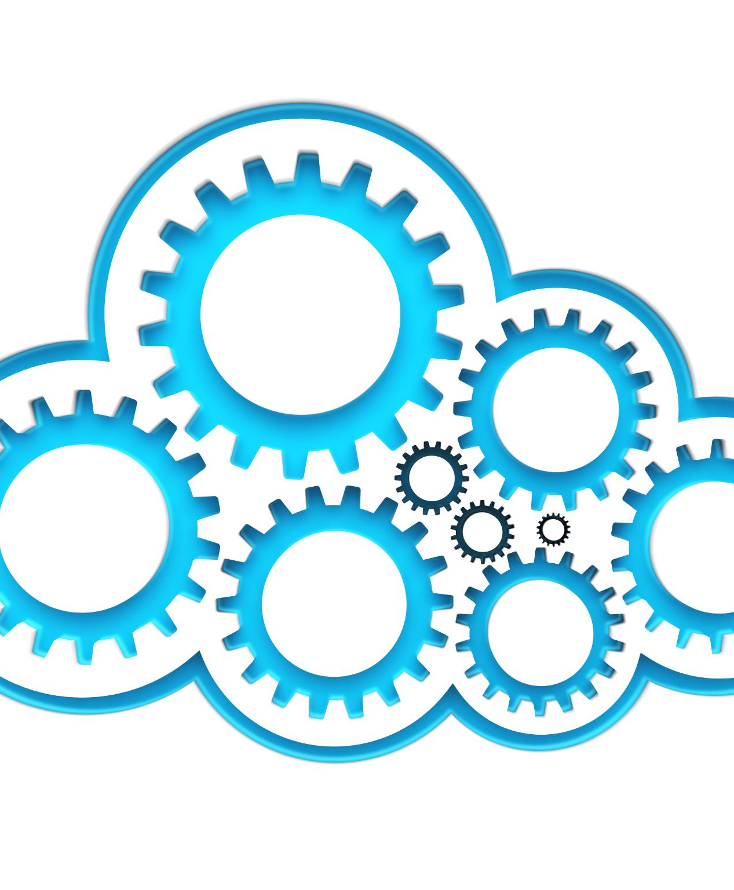
Data Transformation
Definition of Data Transformation
  Data transformation is the process of converting data from one format to another, cleaning, filtering, and enriching data to make it more suitable for analysis.
Data Integration
  Data integration is a part of data transformation that involves combining data from multiple sources into a single, unified view.
Tools for Data Transformation
  Tools such as Apache NiFi, Talend, and SSIS are commonly used for data transformation.
Notes:
Data transformation is the process of cleaning, filtering, and enriching data to make it more suitable for analysis. Data integration from multiple sources is also a part of data transformation. Tools such as Apache NiFi, Talend, and SSIS are commonly used for data transformation.

Slide 7
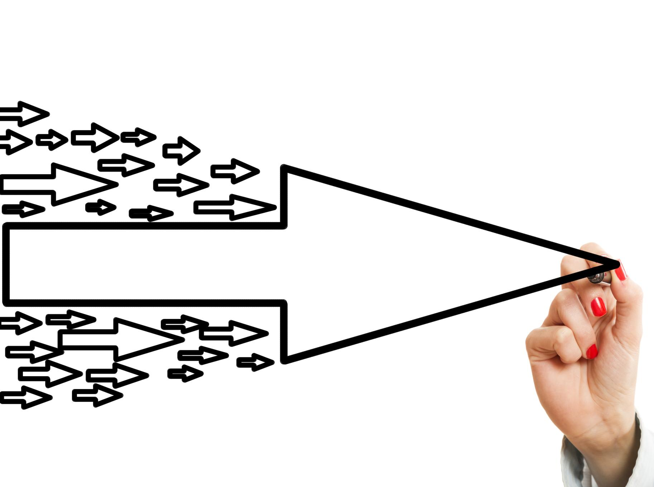
Data processing
Stream processing
  Stream processing is a data processing approach where data is processed in real-time as it is generated, allowing for faster insights and decision-making.
Batch processing
  Batch processing is a data processing approach where data is processed in intervals, allowing for larger volumes of data to be processed at once.
Apache Kafka
  Apache Kafka is an open-source platform for real-time data streaming and processing. It is often used for building real-time data pipelines and streaming applications.
Apache Flink, Spark, and Hive
  Apache Flink, Spark, and Hive are popular tools for batch and stream processing. They offer various features and capabilities for processing large volumes of data efficiently.
Notes:
Data processing refers to the manipulation of data to extract insights and useful information. Stream processing and batch processing are two main approaches to data processing. Popular tools for data processing include Apache Kafka, Apache Flink, Spark, and Hive.

Slide 8
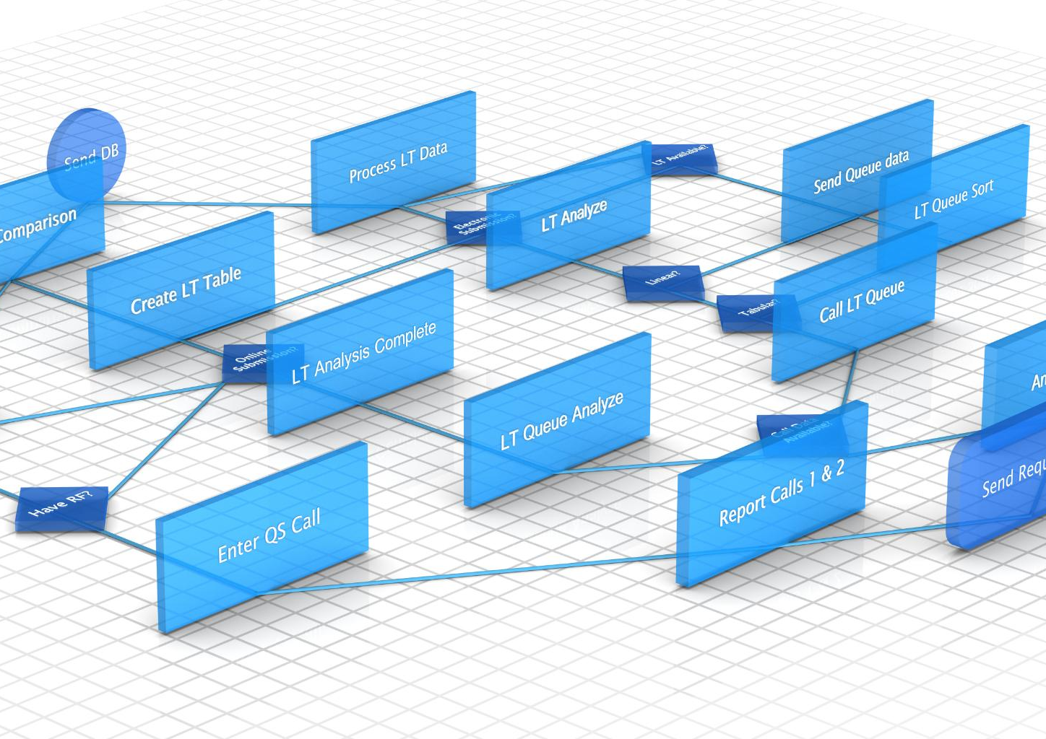
Automating Workflows
  Automating workflows is an essential step towards streamlining data processing. Tools like Airflow and Apache Oozie allow for scheduling and monitoring of workflows, making the data processing process more efficient.
Notes:
Automating workflows is essential for streamlining data processing. Scheduling and monitoring workflows are automated using tools like Airflow and Apache Oozie.

Slide 9

Data Warehouses, Data Marts, Data Lakes
Data Warehouses
  Data Warehouses are widely used in modern data ecosystems for storing large amounts of data from multiple sources. They allow for efficient querying and analysis of data from various sources, enabling businesses to make informed decisions based on the insights gained from the data.
Data Marts
  Data Marts are subsets of Data Warehouses that contain data specific to a particular department or business unit. They allow for quick access to relevant data for decision-making, facilitating agile and efficient business processes.
Data Lakes
  Data Lakes are storage repositories that store raw, unstructured data from various sources. They allow for the storage of data in its original form, enabling flexible and scalable analysis of the data. Data Lakes are used in modern data ecosystems to store data that is not yet ready for analysis or has not yet been identified as valuable.
Notes:
Data storage solutions play a crucial role in modern data ecosystems. In this section, we will explore popular data warehousing solutions, data marts, and data lakes.

Slide 10
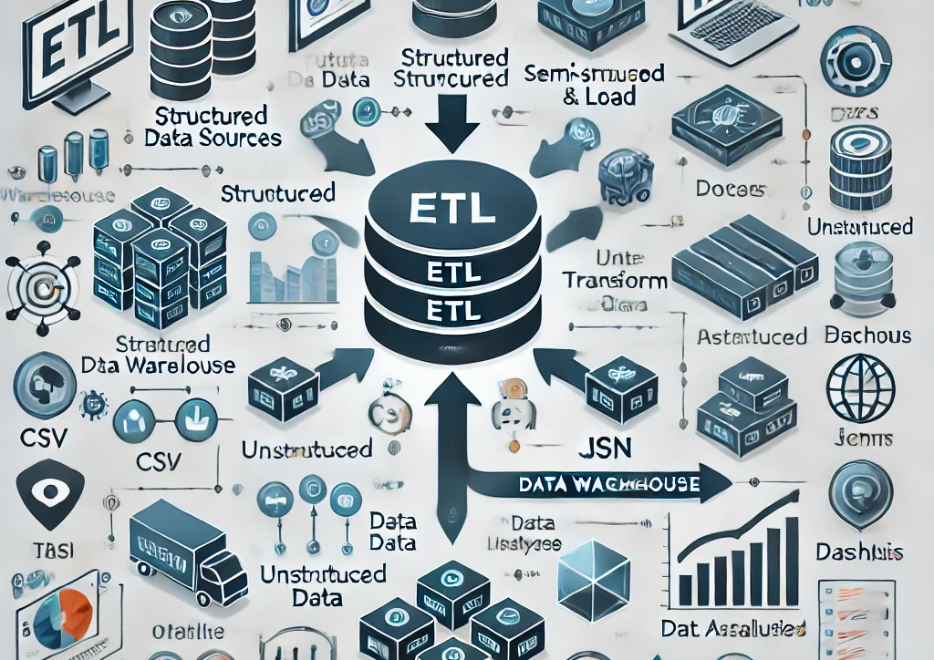
Data Warehouses
  A data warehouse is a central repository of integrated data from various sources. It is designed for OLAP (Online Analytical Processing) and supports complex queries and reporting. Popular data warehousing solutions include Snowflake, Amazon Redshift, and Google BigQuery.
Notes:
A data warehouse is a central repository of integrated data from various sources. It is designed for OLAP (Online Analytical Processing) and supports complex queries and reporting. Popular data warehousing solutions include Snowflake, Amazon Redshift, and Google BigQuery.

Slide 11
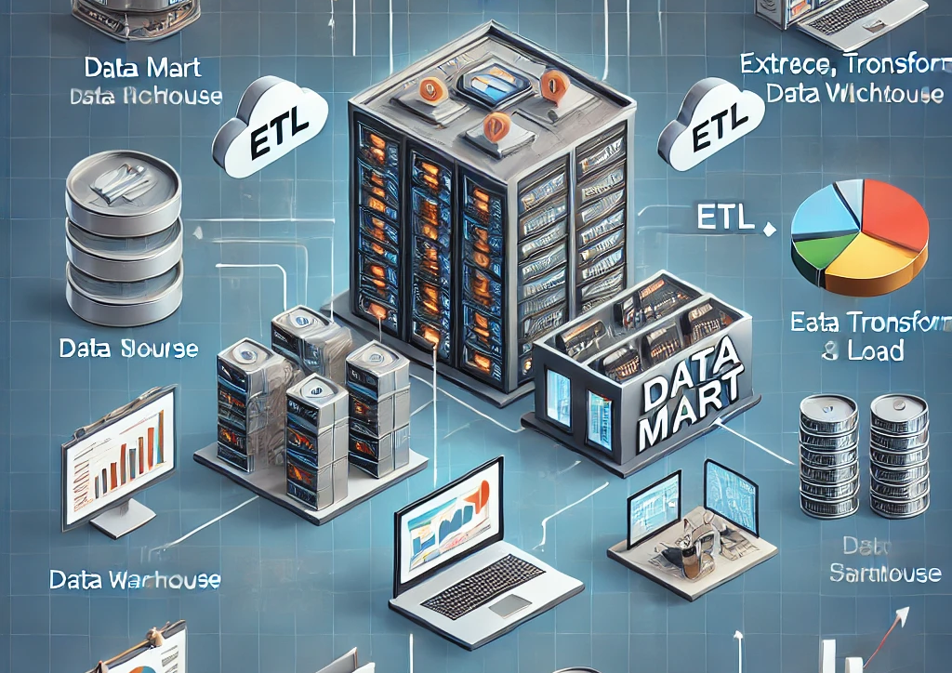
Data marts
Data Mart Overview
  A data mart is a subset of a data warehouse that is designed for specific business units. Data marts are created to help organizations improve their decision-making process by providing quick access to relevant data.
Departmental Analytics and Reporting
  Data marts are typically used for departmental analytics and reporting. They are designed to meet the specific needs of a particular business unit.
Data Warehouse vs Data Mart
  Data warehouses are used for enterprise-wide analytics, while data marts are used for departmental analytics and reporting. Data warehouses are generally larger and more complex than data marts, and they are designed to support a wider range of analytics.
Notes:
A data mart is a subset of a data warehouse that is designed for specific business units. It is typically used for departmental analytics and reporting, while a data warehouse is used for enterprise-wide analytics. Popular data marts include those created using Microsoft SQL Server and Oracle.

Slide 12

Data lakes
Data Storage and Processing
  Data lakes allow for the storage of both structured and unstructured data in raw format, with the ability to process and analyze large amounts of data quickly using machine learning and advanced analytics tools.
Scalability and Flexibility
  Data lakes are highly scalable and flexible, allowing organizations to add more data sources and processing power as needed to support business growth and changing needs.
Popular Data Lake Platforms
  Popular data lake platforms include AWS S3, Azure Data Lake, and Google Cloud Storage, each offering unique features and benefits for storing and processing big data.
  NOTE: AWS S3 stands for Amazon Web Services Simple Storage Service.
Notes:
A data lake is a storage solution that can store both structured and unstructured data in raw format. It is designed for big data processing and supports machine learning and advanced analytics. Popular data lake platforms include AWS S3, Azure Data Lake, and Google Cloud Storage.

Slide 13

Comparing Data Warehouses, Data Marts, and Data Lakes
Data Warehouses
  A data warehouse is a central repository of data that is used to support business decisions. It stores historical data and is optimized for complex queries and analysis.
Data Marts
  A data mart is a subset of a larger data warehouse that is designed to serve a specific business unit or department. It is optimized for quick access and analysis of a specific set of data.
Data Lakes
  A data lake is a large, centralized repository that allows storage of structured, semi-structured and unstructured data at any scale. It is designed to store all types of data and provides a high degree of flexibility.
Notes:
In this section, we will compare and contrast data warehouses, data marts, and data lakes. While each has its own strengths and weaknesses, they complement each other in modern data ecosystems.

Slide 14
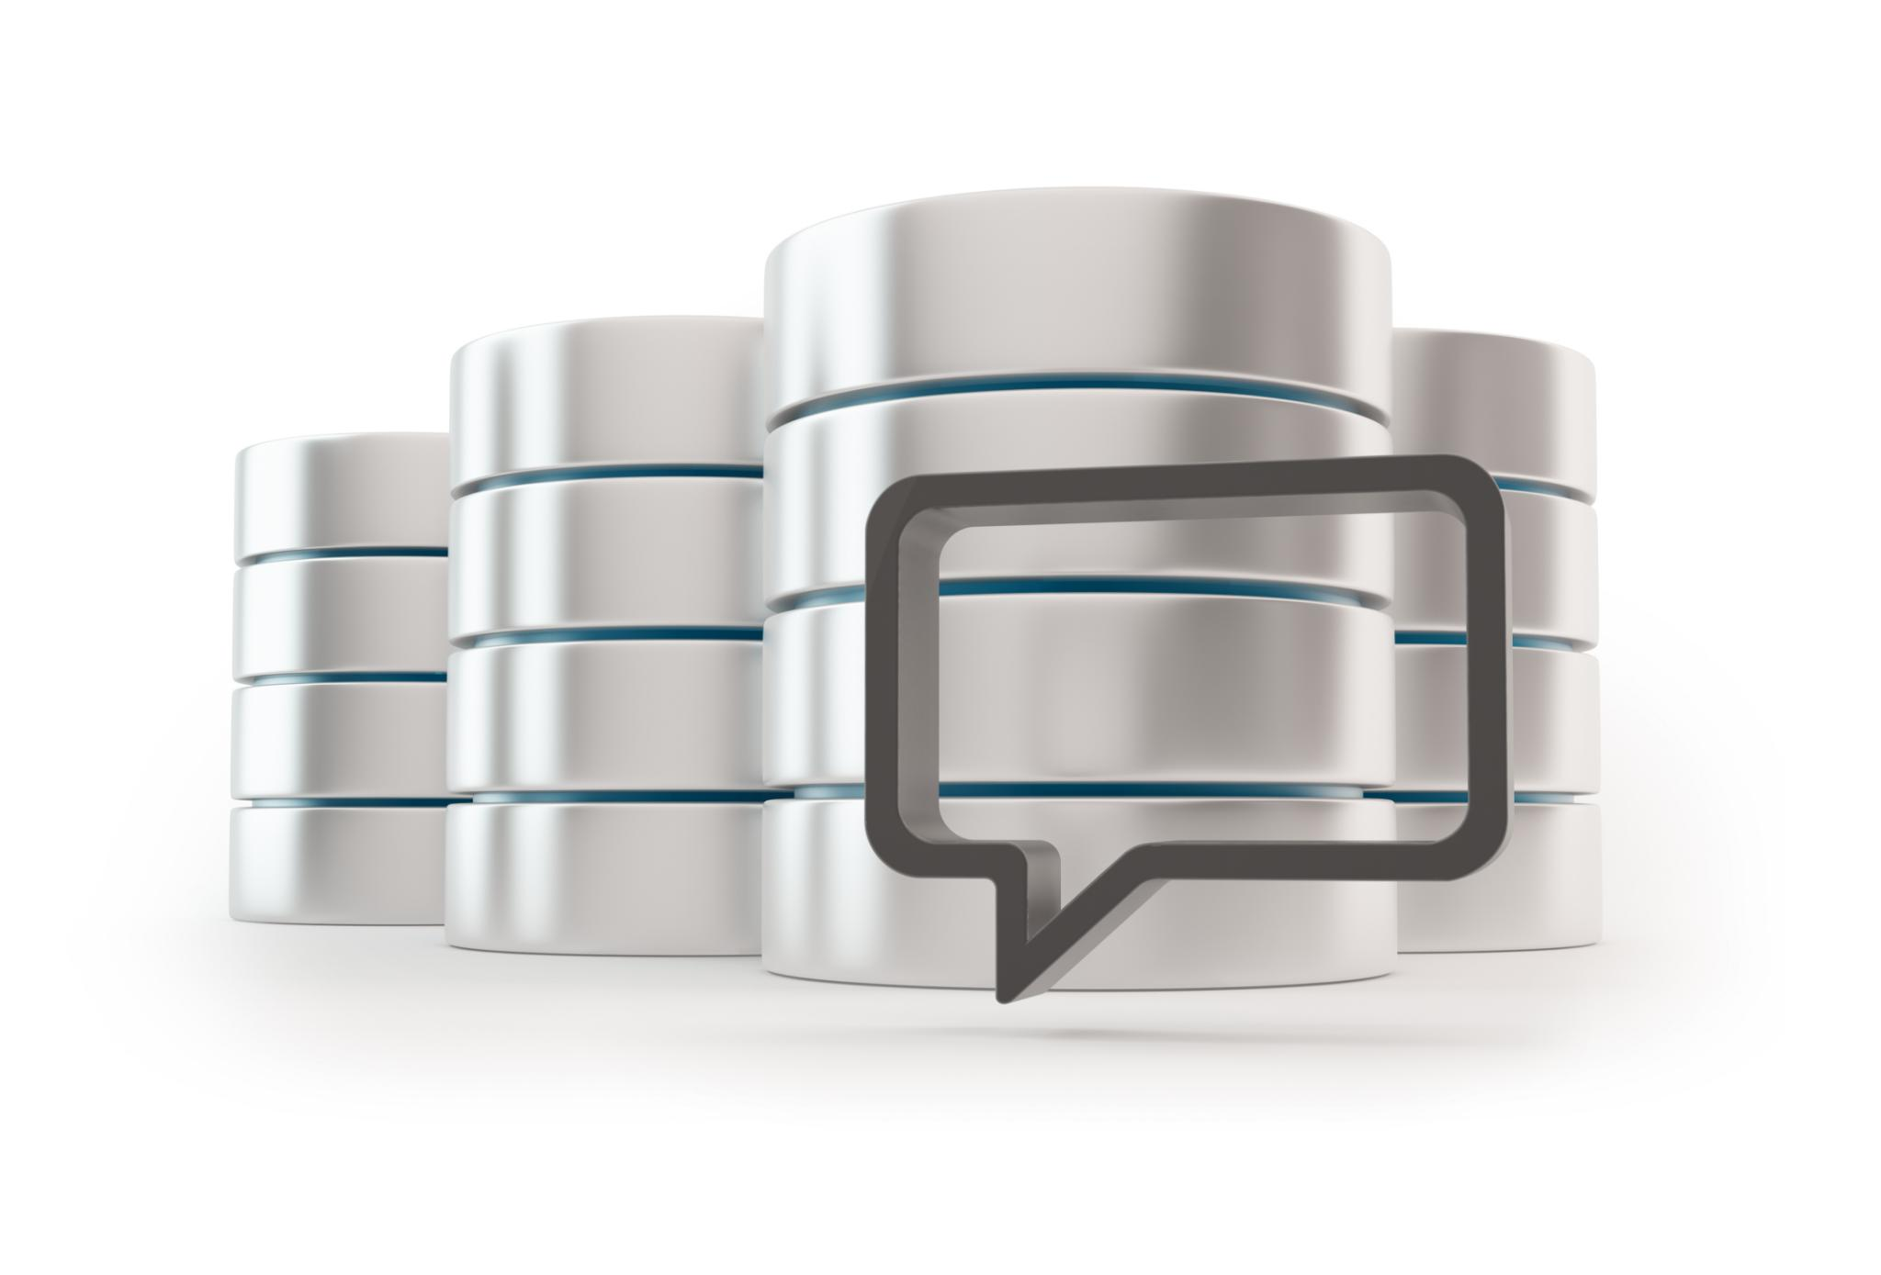
Conclusion
  Understanding data workflows is essential for modern data management and processing. By optimizing data workflows, organizations can reduce errors and improve data quality, leading to better insights and informed decision-making.
Notes:
In conclusion, understanding data workflows and storage solutions is essential for modern data management and processing. By optimizing data workflows and choosing the right storage solution, organizations can derive valuable insights and make informed decisions.

